Slide 1

Movies Recommendation System
Group-6
DSCI 521
Martin Mathew, Atheer Albarqi, Emily Wang, Abhijit Purru

Slide 2
OUR TEAM Intro and contributions
Atheer Albarqi:
Major: AI and Machine Learning
Contributions: EDA, Model selection, Materials Preparation, Team collaboration.
Abhijit Purru:
Major: Data Science
Contributions: Preprocessing, Visualizations, Team Collaboration.
Emily Wang:
Major: Data Science
Contributions: Combining Data, Machine Model, Materials Preparation, Team Collaboration.
Martin Mathew:
Major: Data Science
Contributions: EDA, Model selection, Materials Preparation, Team collaboration.

Slide 3
Contents
Introduction
Related Work
Dataset and Methods
Data Pre-Processing
EDA
KNN Model
Results
Collaborative filtering
Future Work
Overview

Slide 4
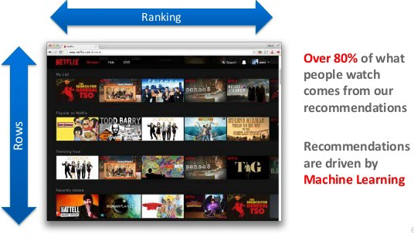
Introduction - Recommendation Systems
Data is being used to create more efficient systems and this is where Recommendation Systems come Into play.
Recommendation Systems are:
Improve the quality of search results
The recommendation system determines the application of projects/services that users currently need or are interested in according to their historical behaviors, social relations, interest points and other information.
Recommendations are predictions of how much a user likes an item he hasn't used before (usually in a rating mechanism).
Provides items that are more relevant to the search item
Type of information filtering systems
Solves information overload.

Slide 5
Overview
Data Acquisition and Preprocessing
IMDB
Web scraping
Preprocessing – Merging, Cleaning and Formatting
Exploratory Data Analysis (EDA)
Bar Graph and Line graphs
Pie chart
Histogram
Recommendation System
Collaborative Filtering - matches persons with similar interests and provides recommendations based on this matching.
KNN - determine the corresponding similar movie or a user based on cosine similarity
Results

Slide 6
Datasets and Methods
The dataset is found from this link: (https://datasets.imdbws.com/). It contains many different datasets such as name-basics, title, rating, episode, ect which includes real data with direct movies records from people's searching.
For example: title.ratings.tsv.gz
Contains the IMDb rating and votes information for titles tconst (string)
alphanumeric unique identifier of the title averageRating
weighted average of all the individual user ratings numVotes
number of votes the title has received

Slide 7
Data Pre-Processing
We used Pandas package to process our data
After cleaning the data, we have title, year, genres, average of rating, movie Id and number of votes as our feature.
We dropped missing data, deleted some features that we didn’t need
Downloaded files using BeautifulSoup

Slide 8
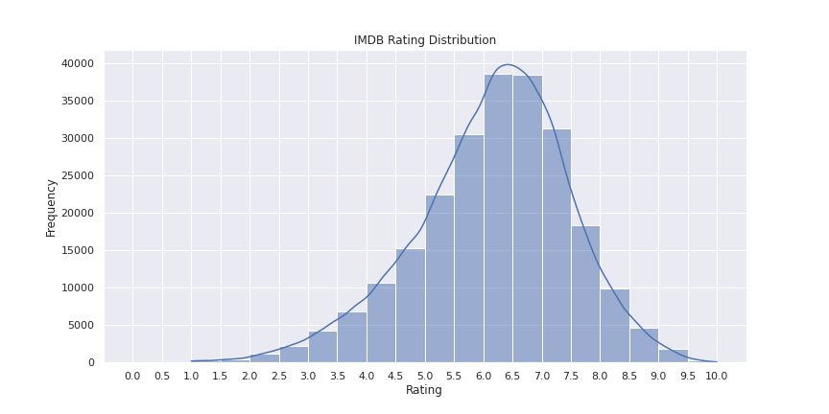
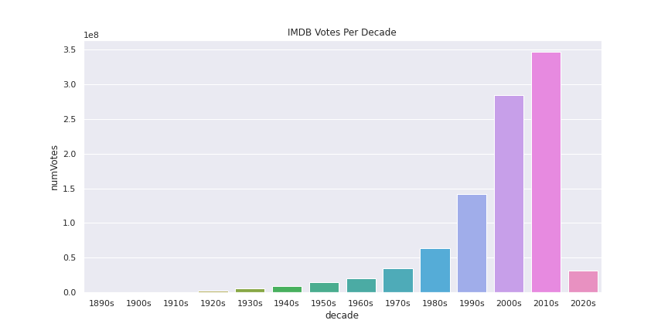
Exploratory Data Analysis

Slide 9
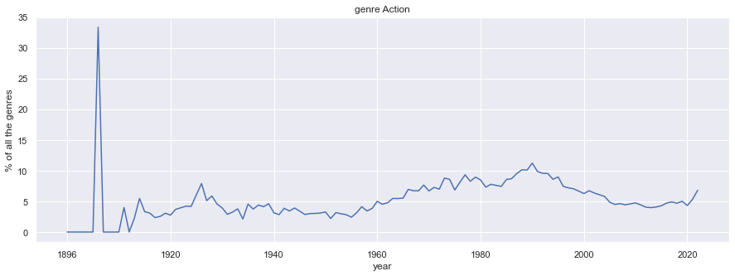
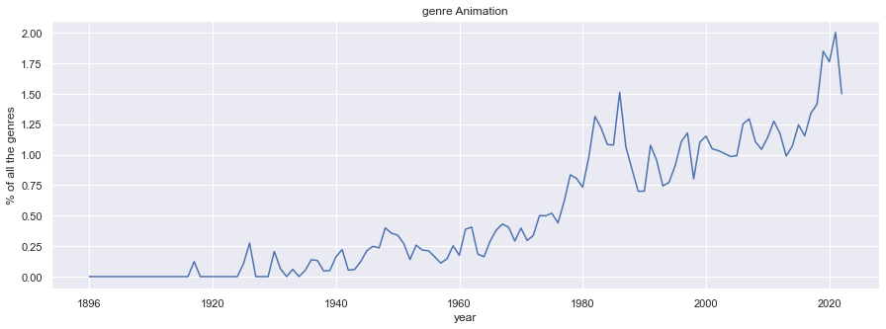
Exploratory Data Analysis
We have 8 EDA graphs about different genres
The two as our examples

Slide 10
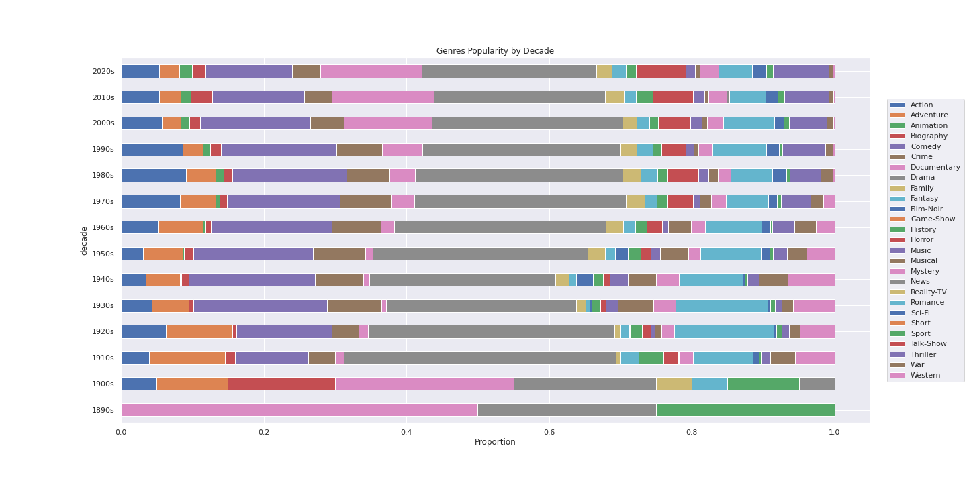
Exploratory Data Analysis

Slide 11
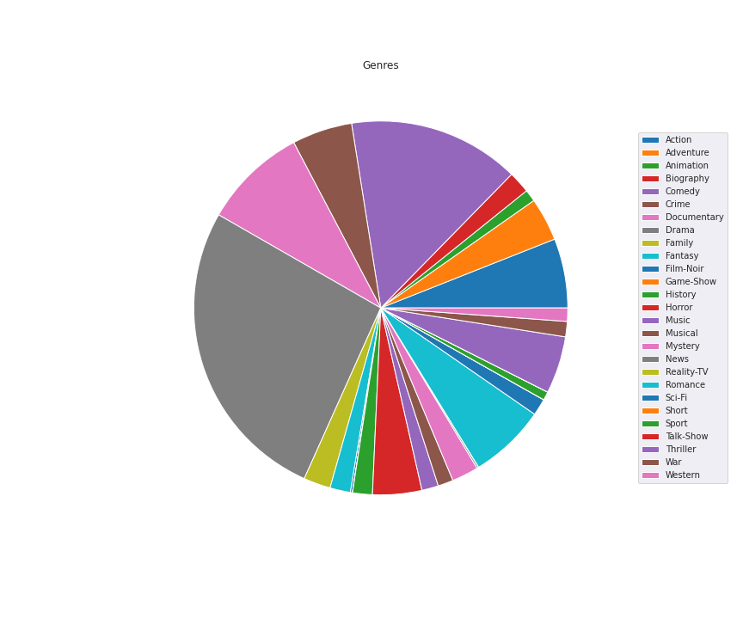
Exploratory Data Analysis

Slide 12
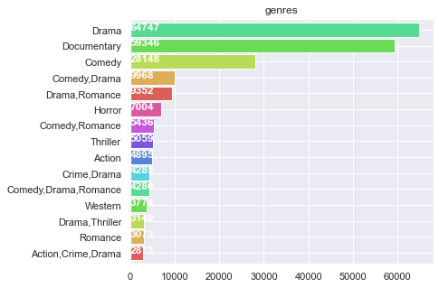
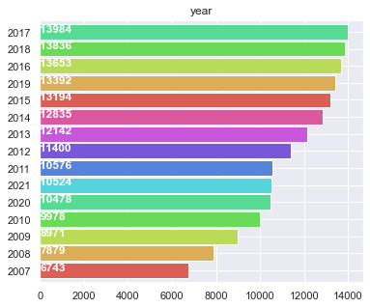
Exploratory Data Analysis

Slide 13

Three Types of Recommender systems
Demographic Filtering- They offer generalized recommendations to every user, based on movie popularity and/or genre. The System recommends the same movies to users with similar demographic features.
Content Based Filtering- They suggest similar items based on a particular item. This system uses item metadata, such as genre, director, description, actors, etc. for movies, to make these recommendations.
Collaborative Filtering- Collaborative filtering is based on the assumption that people who agreed in the past will agree in the future, and that they will like similar kinds of items as they liked in the past. The system generates recommendations using only information about rating profiles for different users or items.

Slide 14
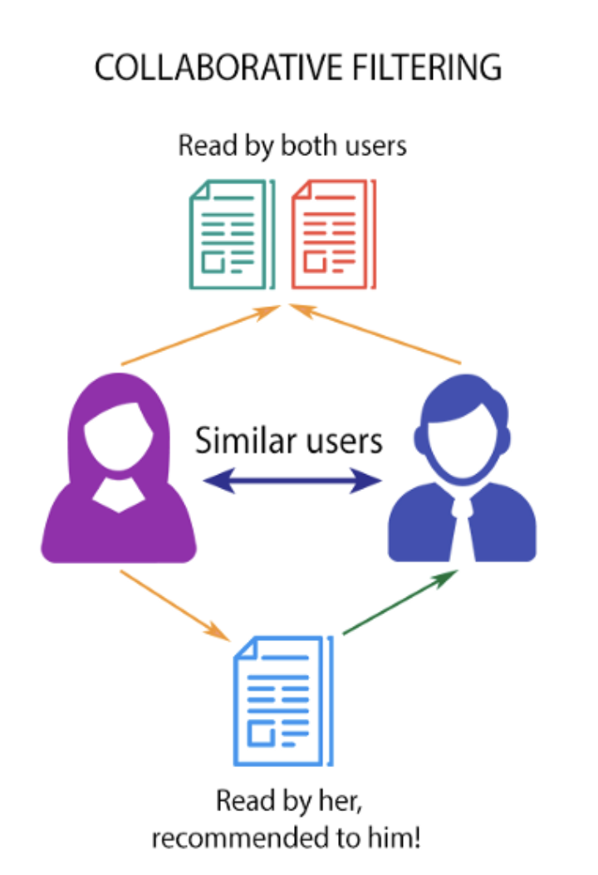
Collaborative filtering

Slide 15
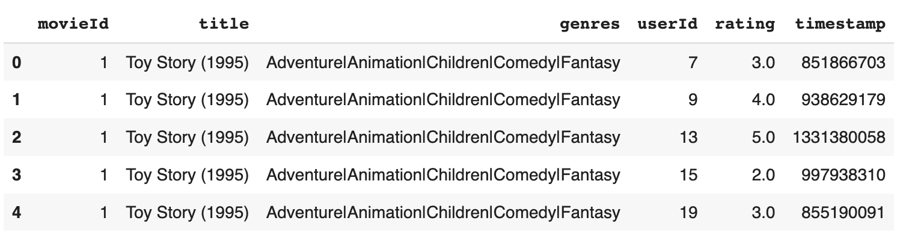
KNN Model
K-Nearest Neighbor (KNN) classification algorithm is one of the simplest methods in data mining classification. K nearest neighbors, means that every sample can be represented by its K nearest neighbors.
KNN algorithm is used to determine the corresponding similar movie or a user based on cosine similarity. K value is defined and desired number of nearest neighboring movies/users are returned.
A new dataset is created from the existing merged dataset by grouping the unique user id and movie title combination and the ratings by a user to the same movie in different instances (timestamps) are averaged and stored in the new dataset.

Slide 16
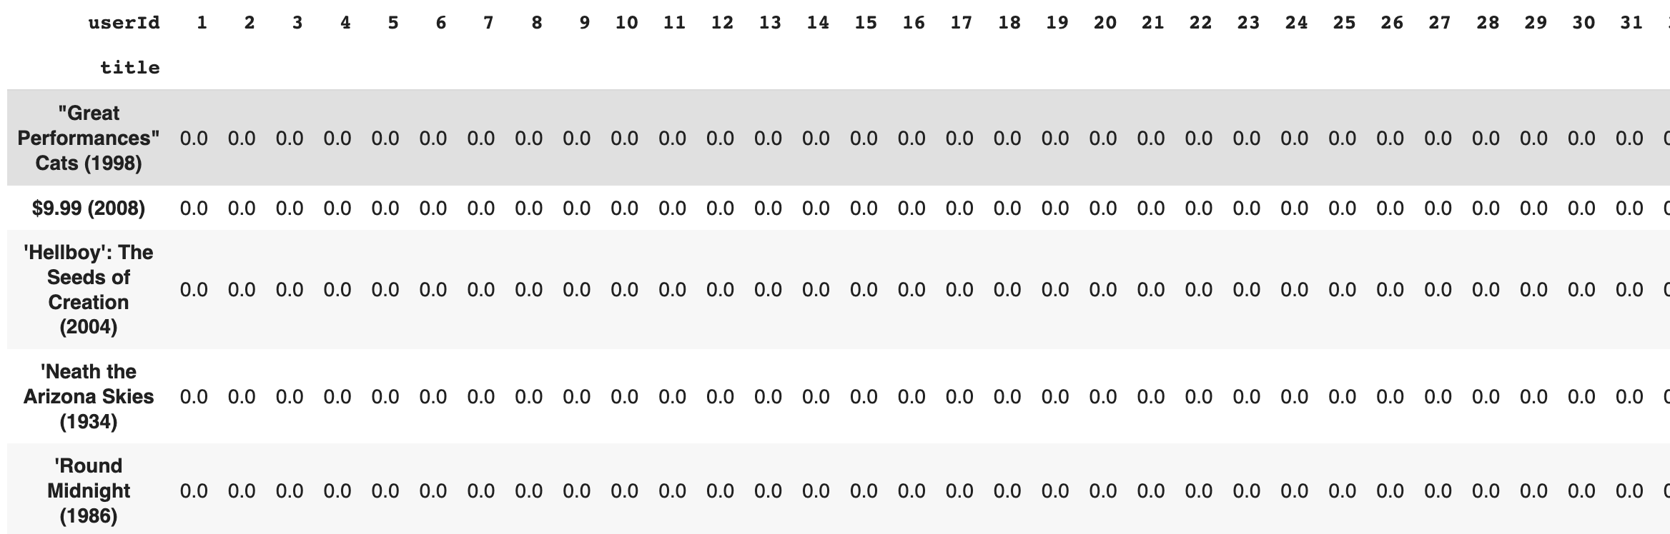
Reshaping model in such a way that each movie (rows) has n-dimensional rating space where n is total number of users (columns)who could rate, the rate will be the value
Pivot and create movie-user matrix
Reshaping the dataframe to make it compatible for KNN algorithm implementation

Slide 17
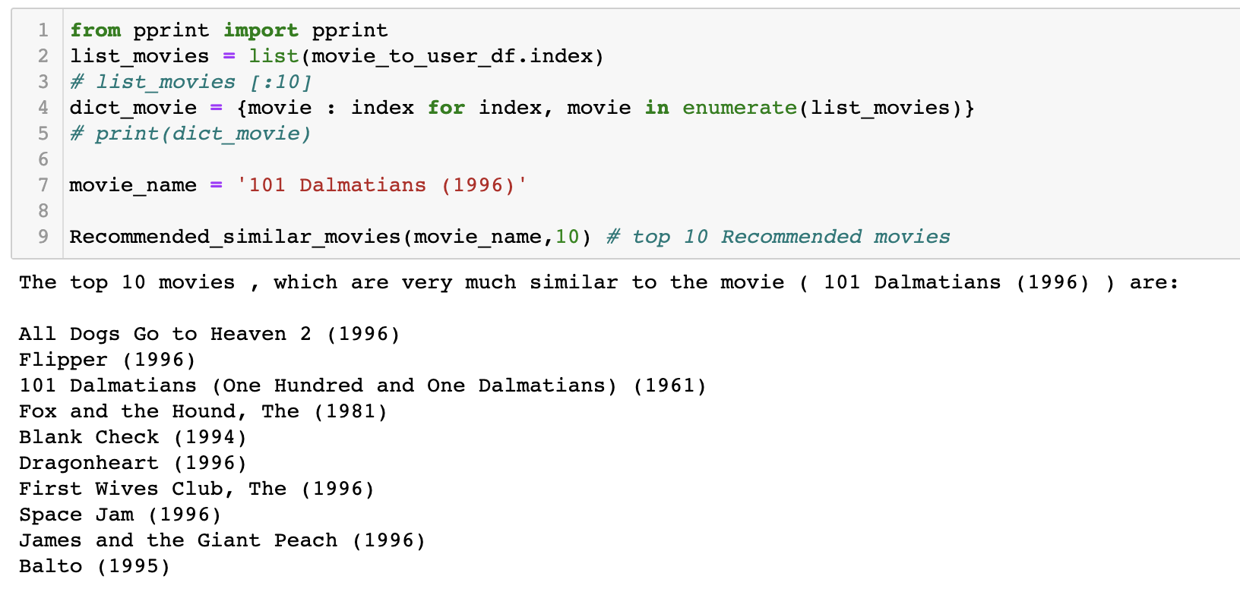
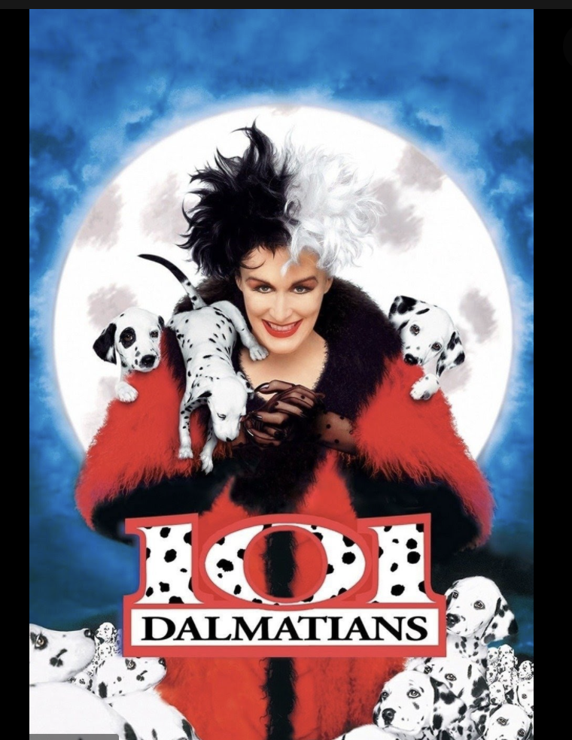
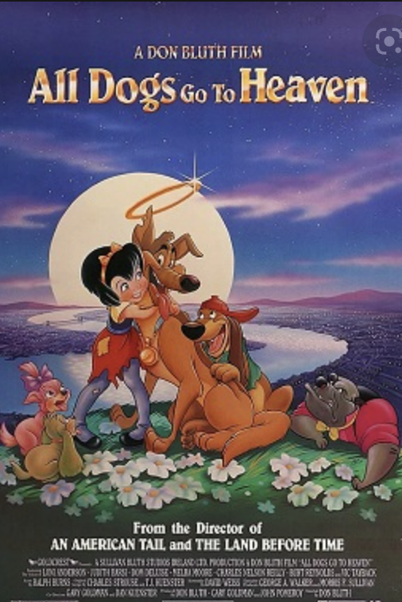

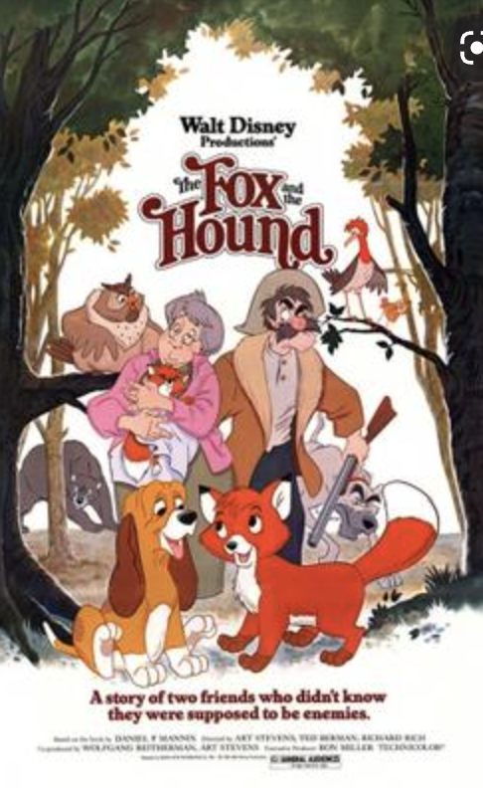
KNN Model -- Result

Slide 18
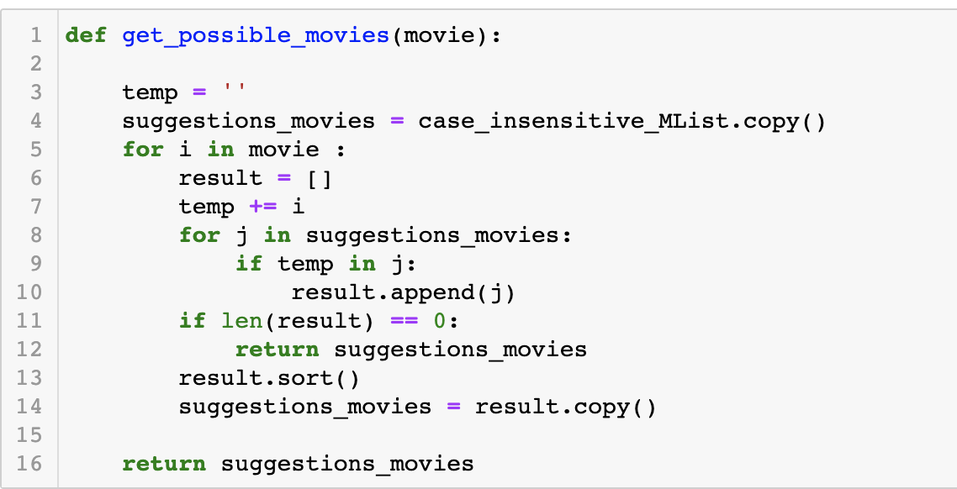
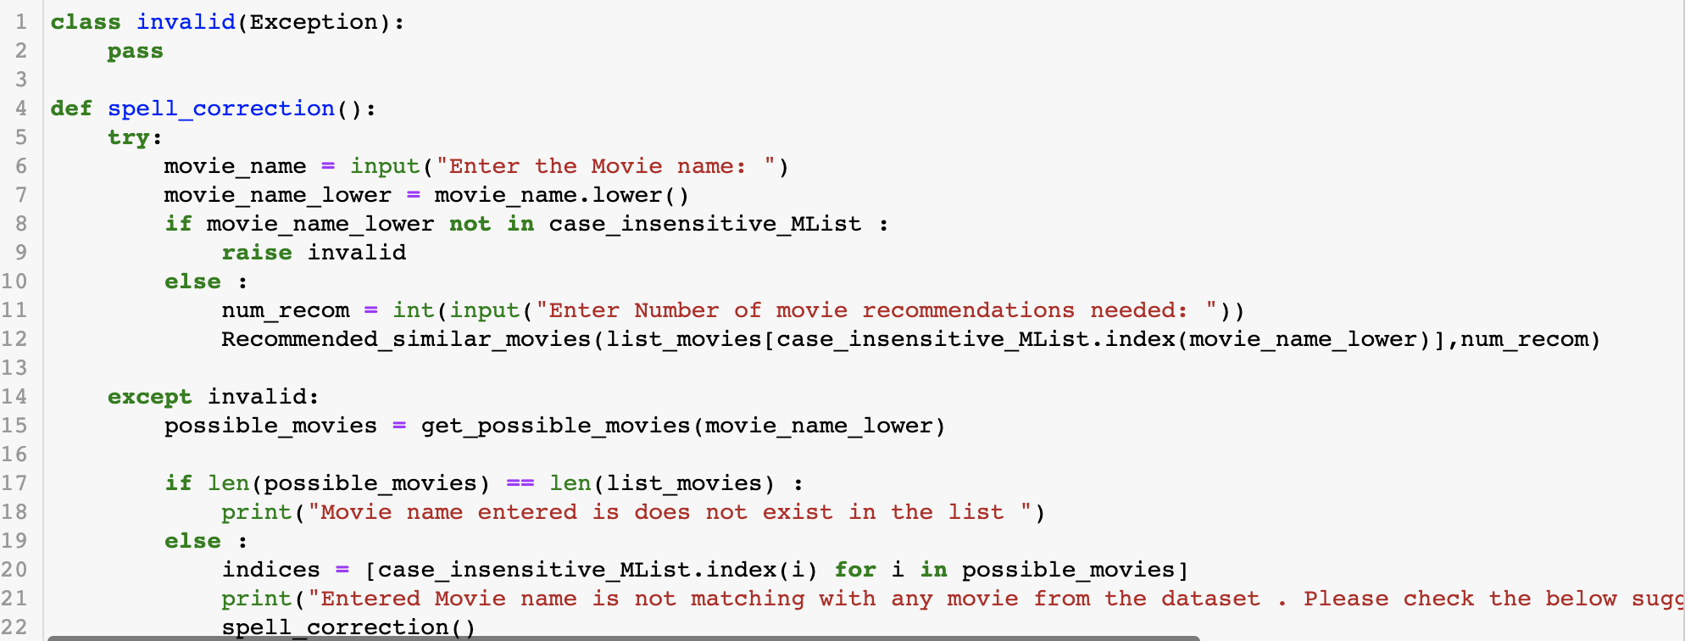
Challenge: Dynamically suggesting movie name
The major challenge is not to recommend similar movie titles, it is to let the user type in the correct movie title.
To address this challenge, a new functionality has been written.
This function provides user with movie name suggestions if movie
name is mis-spelled or Recommends similar movies to the input movie if the movie name is valid.
Dynamically suggesting movie name from the existing movie corpus we have, based on the user input using try and except architecture.
function which takes input and returns suggestions for the user

Slide 19
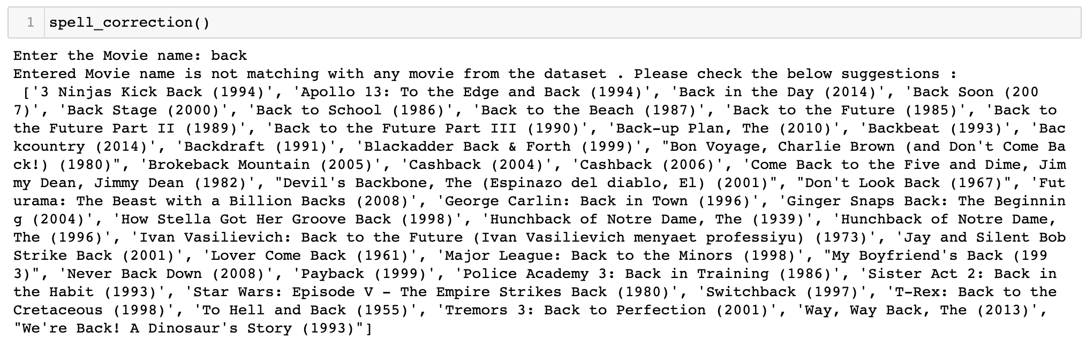
Dynamically suggesting movie name-- results

Slide 20
Future Work
The Collaborative filtering has some disadvantages
Although collaborative filtering as a recommendation mechanism has its application, there are still many problems to be solved. Overall, the most typical problems are:
New User Problem The system started with poor recommendation quality
The quality of the New Item Problem depends on the historical data set
Sparsity Problem
System Scalability problem
So, we will try other different filter functions later.

Slide 21
Related Work
This study is inspired by research paper named "Neural Collaborative Filtering" by Xiangnan He and Xia hu, ect. We learned the basic knowledge about Collaborative Filtering method for our recommender systems.
Another inspiration in the project by the project “TMDB Score Prediction”, which used a similar dataset to determine the success of movies prediction. (https://www.kaggle.com/heeraldedhia/movie-ratings-and-recommendation-using-knn)

Slide 22
Thank You!

